Slide 1

Car Price Prediction using Ridge Regression – A Streamlit App
Intro to Informatics : INFO I-501
Raj Acharya

Slide 2
Introduction to cars
Dataset Selection.
Data Refinement
Need for Prediction of Car pricing
Dataset on Car Features

Slide 3

About the Dataset
Dataset from Edmunds
Car Features like Make, Model, Year, MPG, Engine Cylinder and others
Data processing and sorting.
Removal of outliers and adding missing values.

Slide 4

Using One hot Encoding
Used for representing a categorial variable and numerical value.
Used in machine learning model
Used in my project to give accurate predictions with the use of numerical data.
Provides more information about the categorical data.

Slide 5

Ridge Regression for Training model.
Helps controlling paying more attention to a single feature.
Discourages focus on single features and correlates on using all features.
Using L2 regularization for smoothening the model.
Ridge Regression ensures the model considers all aspects
Adds a kind of common sense to the model.

Slide 6
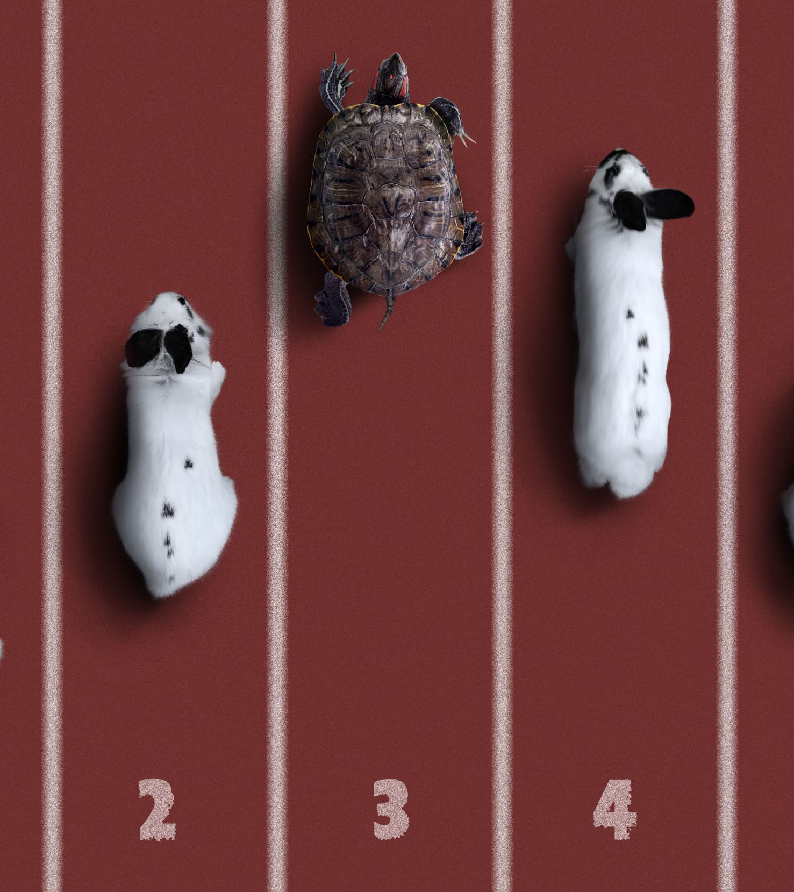
Libraries Used
For Data Analysis : Numpy and Pandas
For Model Building : Scikit Learn and Pickle
Web App : Streamlit
Additional Libraries: Jupyter notebook and Matplotlib and Seaborn

Slide 7
The model Accuracy
StandardScaler:. This improved the performance of Ridge Regression, which can be sensitive to different feature scales.
Train_test_split: splitting the data into training and testing sets, ensured the model learns from diverse data and doesn't simply memorize the training set.
Mean_squared_error (MSE) and r2_score: Was helpful in depiction correlation of 96% accuracy between Pricing and Features.

Slide 8
Building the Web App
Using Streamlit for building the web app because of its ease and user friendliness.
Used pickle file with ridge regression to come by to the outcome.

Slide 9
Using the Application
The App Interface is easy to read and we follow the values and feed in the data and Click the Predict Button to get the Desired Outcome.
Inputs the values to get the outcome.
Pickle file acts as the brain to the core and helps in preloading the model so that it doesn’t have to go through the same process again.
We follow the features and keep adding values to the Web App and we can get a desired outcome on the basis of the inputs that are provided

Slide 10
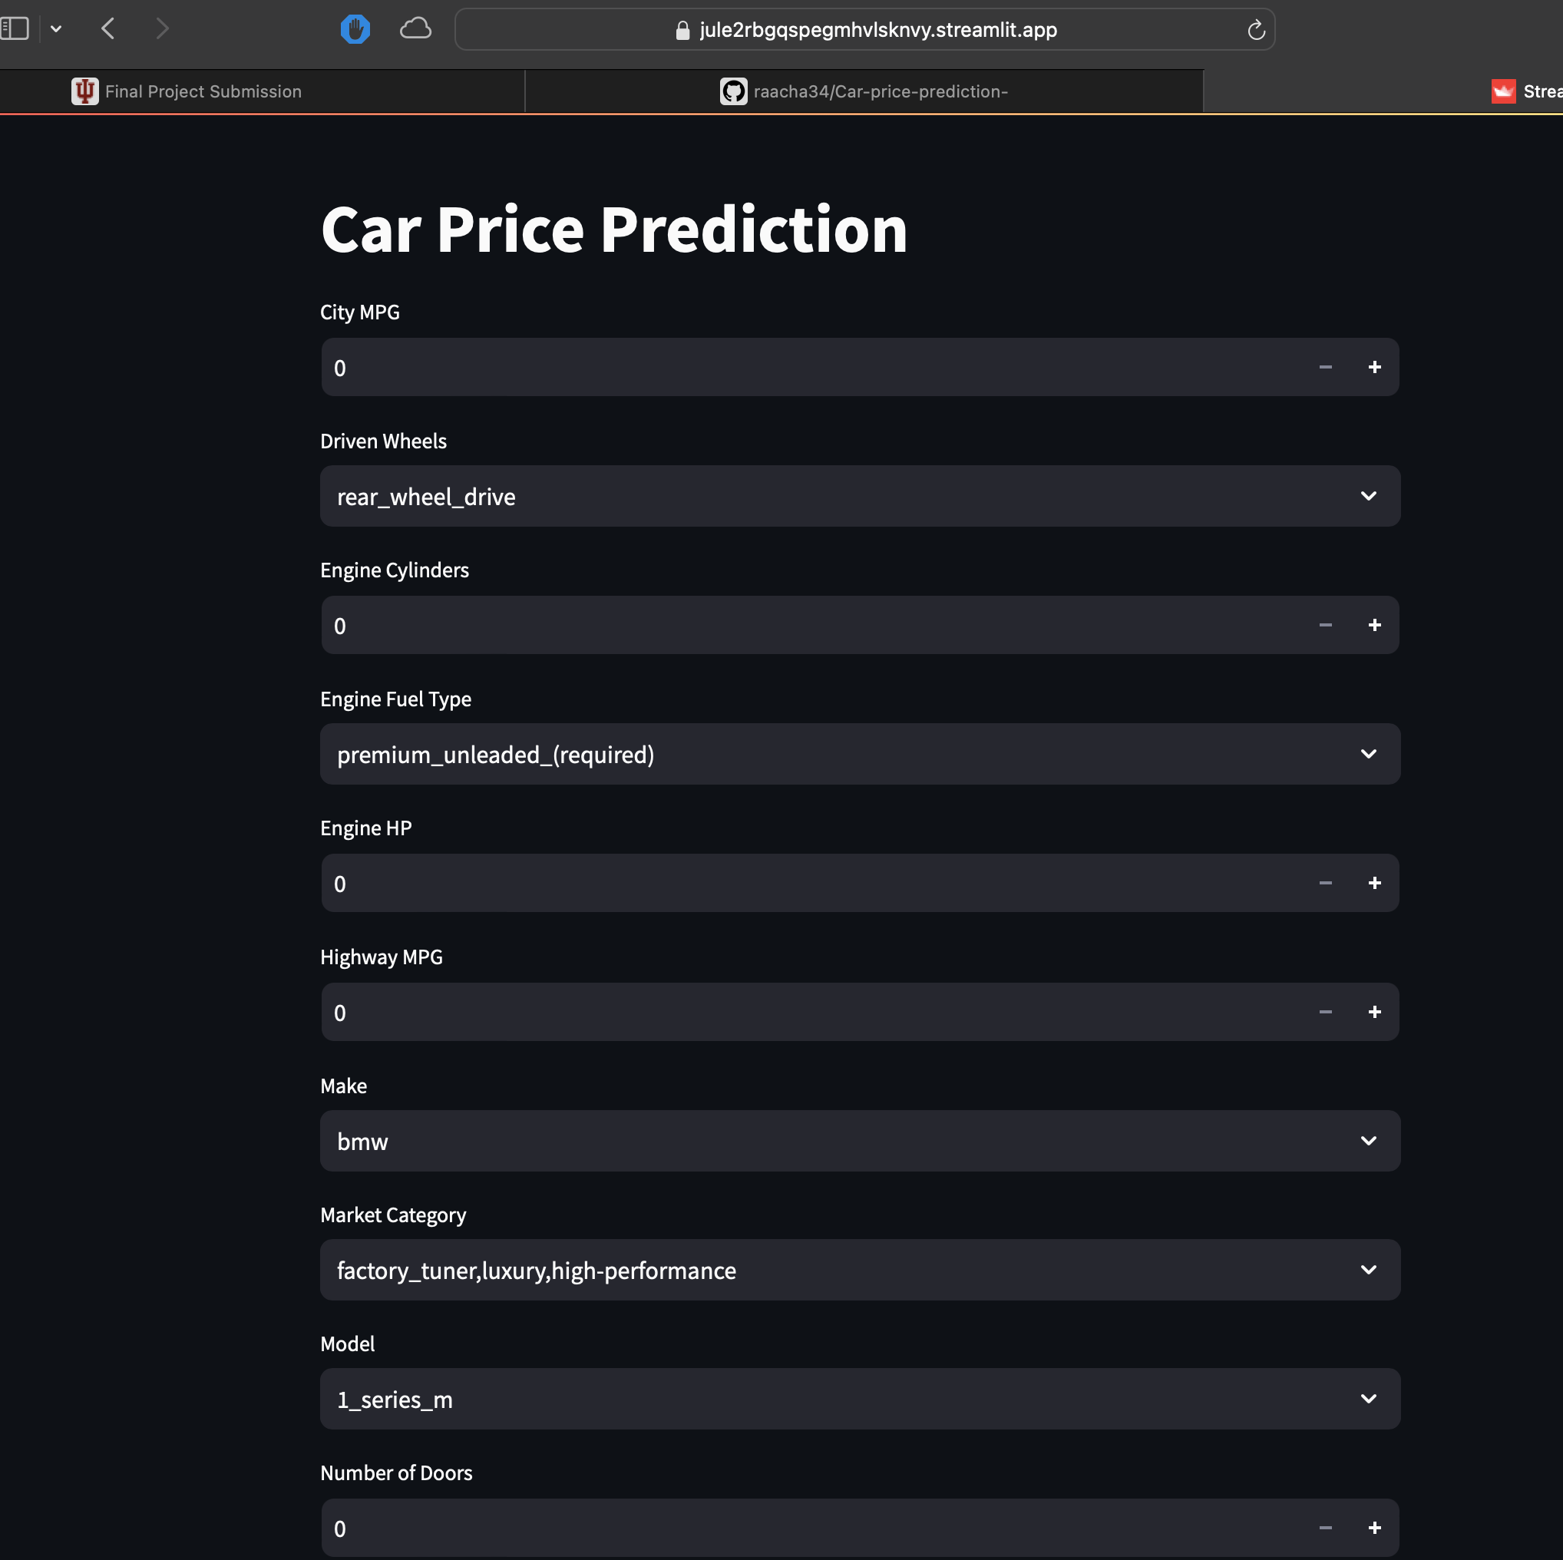
A visual Depiction
Easy to view Features
Feature Selection from Drop down menu.
Predicted outcome instantly

Slide 11
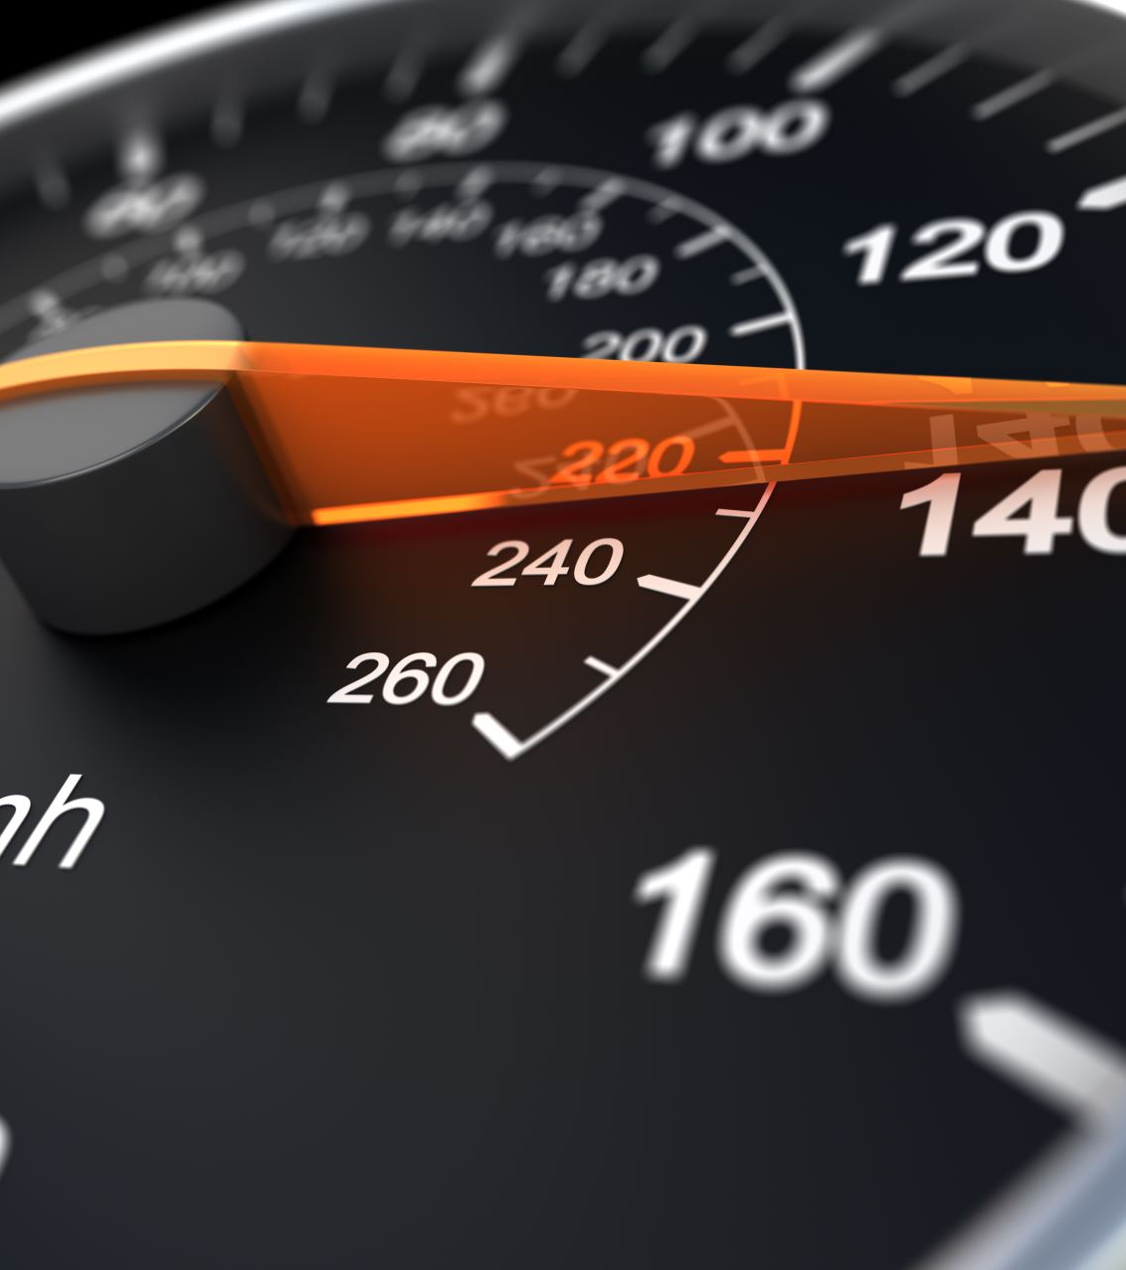
Application in Action
Let’s go to Streamlit and test out the Application ourselves.
Car Price Prediction App

Slide 12

Outcome of the App
Its useful in giving a prediction of the car pricing based upon the dynamic features.
Gives a rough idea on what pricing we should expect
Limitations are we need to continuously keep on updating the car features and train the model based upon new features to keep it up and running.
Usable to a number of people who are in search of a new car and wants a definite price prediction.

Slide 13

Conclusion and Future Outcome
Make changes to the App to make it more effective.
Deploying on a public platform to make it useful to a widespread audience.

